Slide 1

Erfinden Technologies
Explore The World of Business

Slide 2

OUR BIG IDEA
Business Consulting is at the core of our services. We have built repute on an age old consulting services globally. Our Satisfied customers is our key selling point.
We build Business for the World.

Slide 3


1. INTRODUCTION
Motivation
BCG, Bain & Company, and McKinsey & Company have established themselves as leaders in the management consulting industry, providing innovative solutions and strategic insights to clients worldwide. The motivation behind this project stems from the desire to analyze and leverage the expertise of these top consulting firms to enhance business consultancy practices.
Problem Statement
Despite the wealth of knowledge and resources available from BCG, Bain & Company, and McKinsey & Company, there is a need to consolidate and analyze their insights systematically to extract actionable recommendations for clients. This project aims to address this challenge by acquiring and synthesizing data from these firms to inform strategic decision-making.

Slide 4
Purpose
The purpose of this project is to gather data from BCG, Bain & Company, and McKinsey & Company and analyze it to identify trends, best practices, and strategic recommendations. The primary objective is to develop actionable insights that can be used to drive business growth, improve operational efficiency, and enhance competitiveness. The goals include:
Extracting key insights from the data provided by BCG, Bain & Company, and McKinsey & Company.
Identifying common trends and best practices across industries and functional areas.
Formulating actionable recommendations tailored to the needs of clients.
Literature Survey
A review of existing literature, including reports, case studies, and whitepapers from BCG, Bain & Company, and McKinsey & Company, will be conducted to gather relevant insights and methodologies employed by these firms in solving complex business challenges.

Slide 5
2. SYSTEM ANALYSIS
Comparative Study of Existing Systems:
An analysis will be conducted to compare the methodologies, frameworks, and approaches used by BCG,
Bain & Company, and McKinsey & Company in their consulting engagements. This will involve examining the
key features, strengths, weaknesses, and limitations of each firm's approach.
Scope and Limitations of Existing Systems:
The scope of the analysis will encompass data obtained from BCG, Bain & Company, and McKinsey & Company,
focusing on their strategic insights, industry expertise, and best practices. Limitations may include the availability
and depth of data provided by each firm, as well as potential biases in the analysis.

Slide 6
Project Perspective and Features:
The purpose of this project is to gather data from BCG, Bain & Company, and McKinsey & Company and analyze
it to identify trends, best practices, and strategic recommendations. The primary objective is to develop actionable
insights that can be used to drive business growth, improve operational efficiency, and enhance competitiveness.
The goals include:
Extracting key insights from the data provided by BCG, Bain & Company, and McKinsey & Company.
Identifying common trends and best practices across industries and functional areas.
Formulating actionable recommendations tailored to the needs of clients.
Literature Survey
A review of existing literature, including reports, case studies, and whitepapers from BCG, Bain & Company, and
McKinsey & Company, will be conducted to gather relevant insights and methodologies employed by these firms
in solving complex business challenges.

Slide 7
Project Perspective and Features:
This project adopts a collaborative approach, leveraging the expertise of BCG, Bain & Company, and McKinsey
& Company to generate actionable recommendations for clients. Key features include:
Data acquisition from top consulting firms.
Comparative analysis of strategic insights and best practices.
Formulation of tailored recommendations based on client needs.
Stakeholders:
Stakeholders involved in this project include clients seeking strategic guidance, consultants facilitating the analysis,
and executives responsible for implementing recommendations. Collaboration with BCG, Bain & Company, and
McKinsey & Company ensures alignment with industry standards and best practices.

Slide 8
Requirement Analysis:
Functional requirements include data acquisition, analysis, and recommendation formulation. Performance
requirements involve timely delivery of insights and recommendations. Security requirements ensure
confidentiality and integrity of data obtained from consulting firms.

Slide 9
3. SYSTEM DESIGN
Design Constraints:
Scalability: Ensure that the software can handle a growing number of clients and projects without significant performance degradation.
Security: Implement robust security measures to protect sensitive client information and maintain confidentiality.
Flexibility: Design the software to accommodate various types of consultancy services and adapt to changing client needs.
Usability: Prioritize user-friendly interfaces and intuitive workflows to enhance the user experience for both consultants and clients.
Integration: Consider compatibility with existing business tools and systems that clients may use, such as CRM software or accounting platforms.
Compliance: Adhere to relevant industry regulations and standards, such as GDPR or HIPAA, depending on the nature of the consultancy services provided.

Slide 10
System Model: UML Diagrams
UML Diagrams: Unified Modeling Language (UML) diagrams are graphical representations used to visualize the system's architecture, components, and interactions. Common types of UML diagrams include:Class Diagrams: Illustrate the static structure of the system, showing classes, attributes, methods, and relationships.
Sequence Diagrams: Describe how objects interact over time, showing the sequence of messages exchanged between objects.
Activity Diagrams: Represent the flow of activities or processes within the system, illustrating the sequence of actions and decision points.

Slide 11
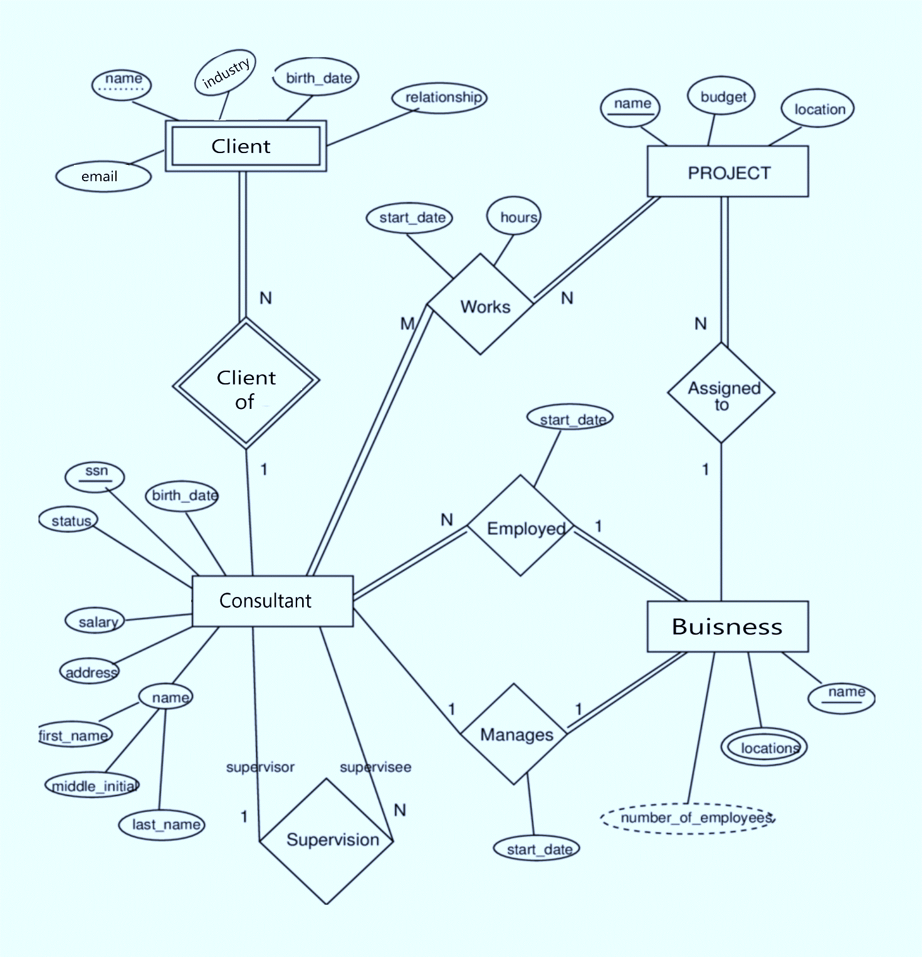
ER Diagram:

Slide 12
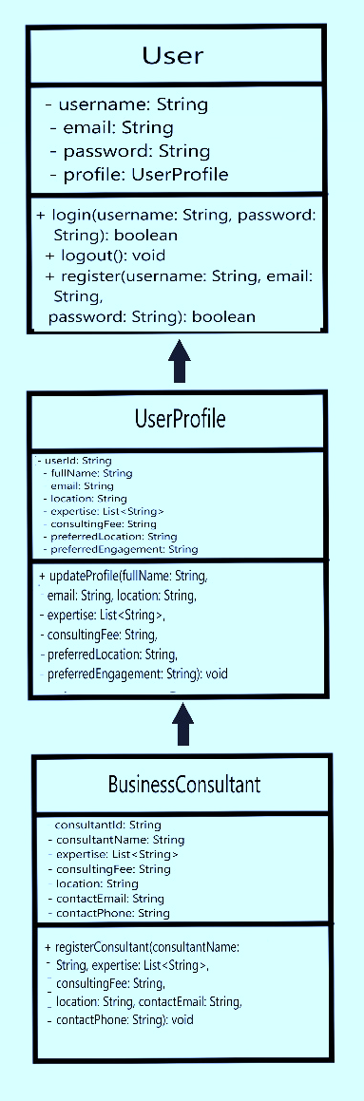
Class Diagram:

Slide 13
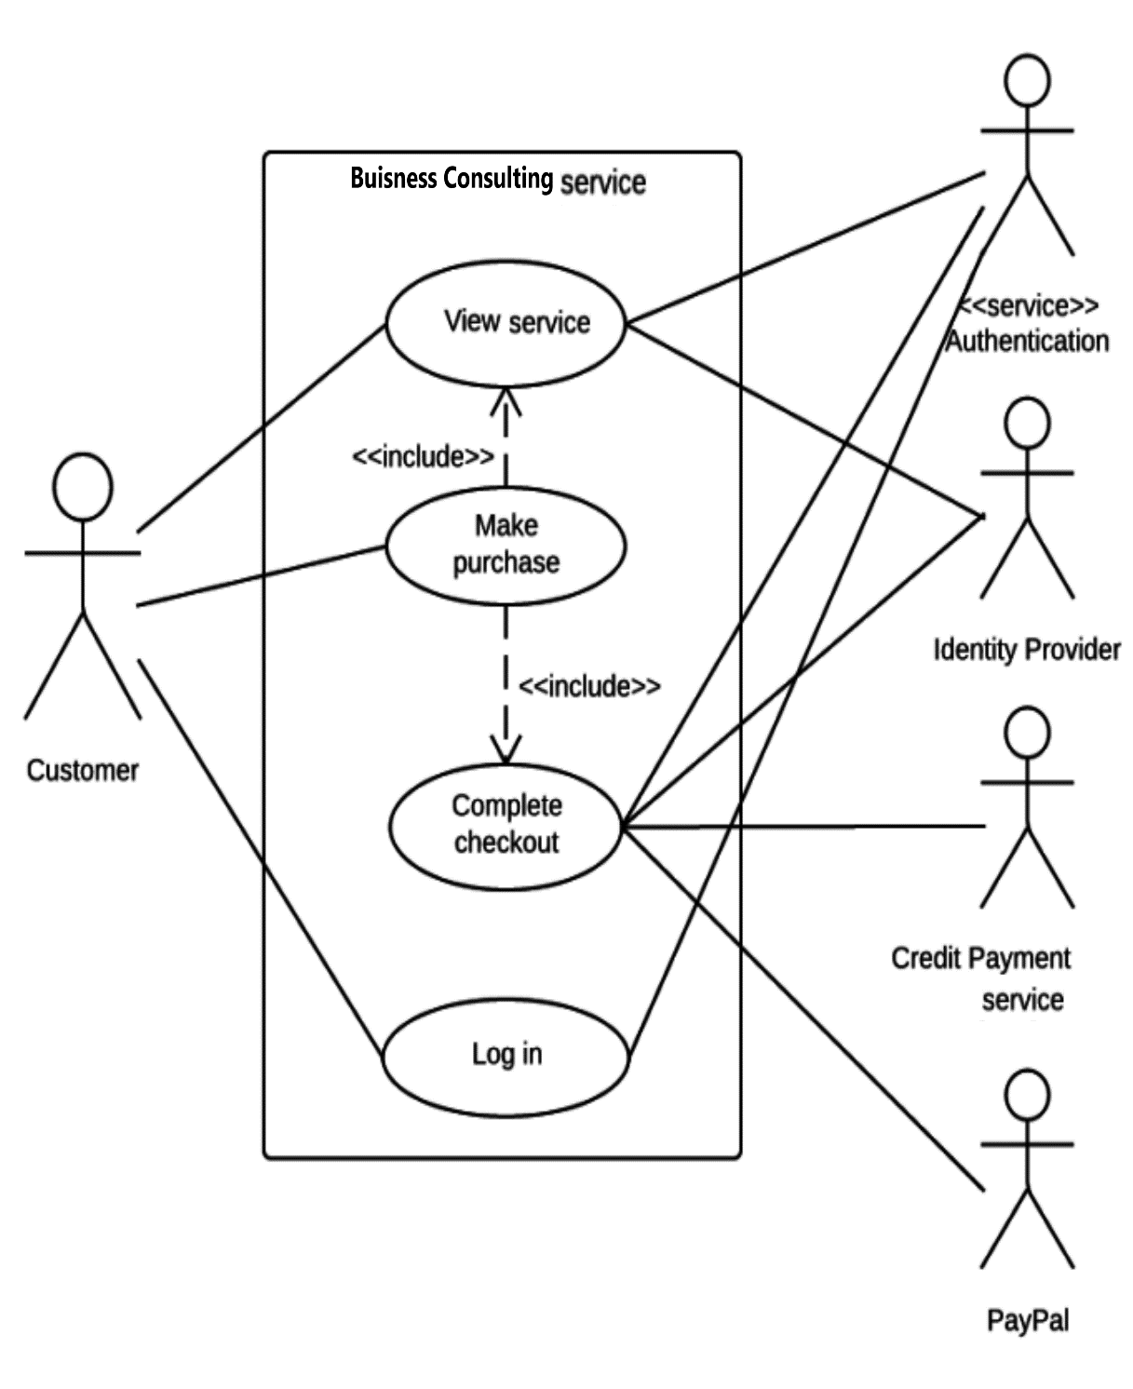
Usecase Diagram:

Slide 14
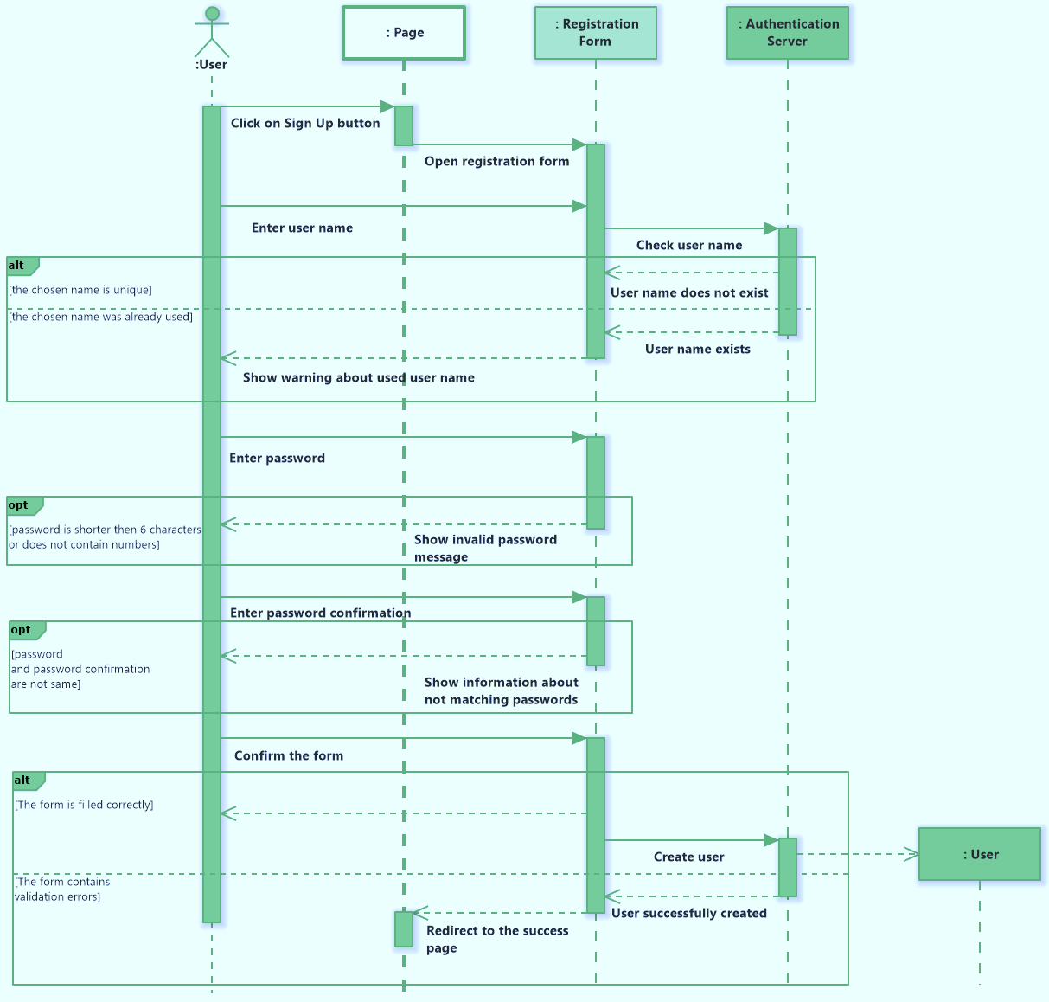
Sequence Diagram:

Slide 15
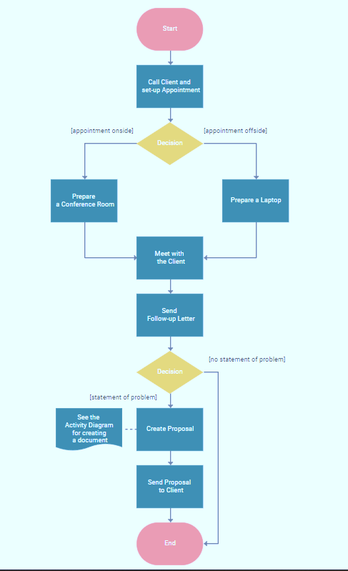
Activity Diagram:

Slide 16
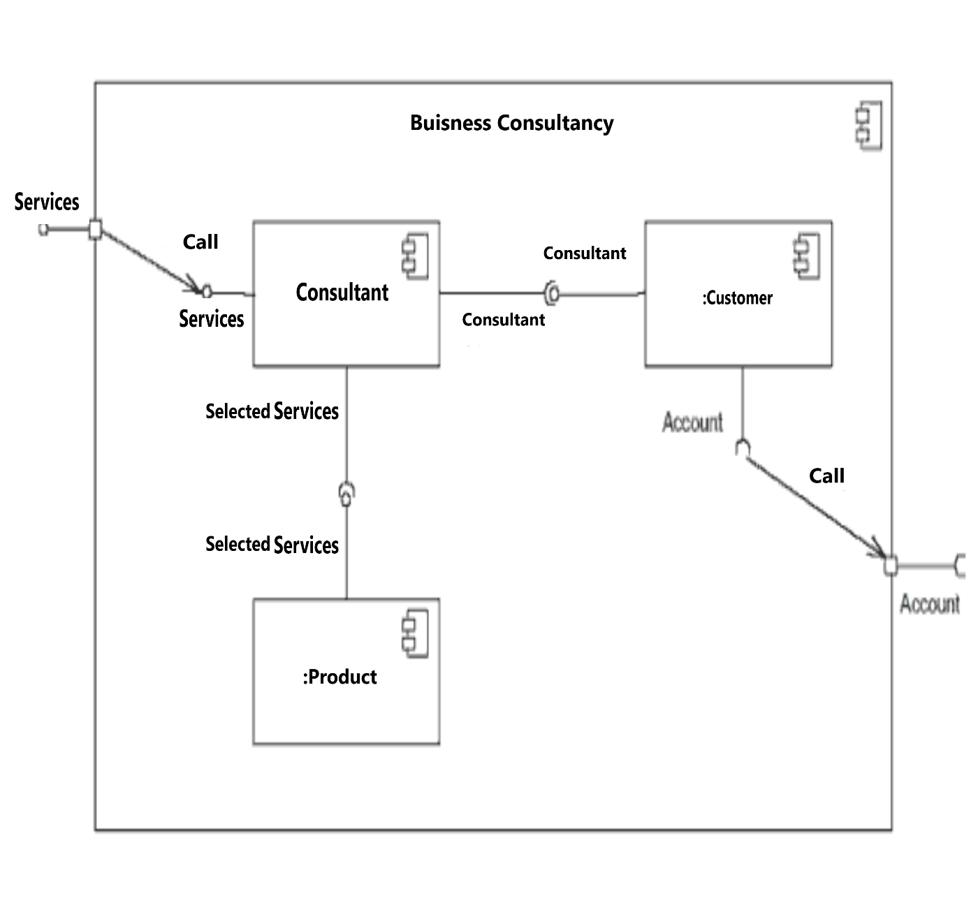
Component Diagram:

Slide 17
Data Model:
Client Information: Store essential client details such as company name, contact information, industry sector, and any specific requirements or preferences.
Project Details: Capture information about each consultancy project, including objectives, scope, timelines, assigned consultants, and progress status.
Consultant Profiles: Maintain profiles for each consultant, including their expertise, qualifications, past projects, and availability.
Engagement History: Track the history of interactions and engagements with each client, including meeting notes, deliverables, and communication logs.
Financial Data: Manage financial aspects such as project budgets, invoices, payments, and expenses.
Document Management: Provide a centralized repository for storing and organizing documents related to client projects, such as reports, presentations, and contracts.
Analytics and Reporting: Collect data for performance metrics and generate reports to assess the effectiveness of consultancy services and identify areas for improvement.

Slide 18
User Interfaces:
Dashboard: Create a customizable dashboard for consultants to get an overview of their upcoming tasks, project statuses, and key performance indicators.
Client Portal: Develop a client portal where clients can access project updates, review documents, and communicate with their consultants.
Project Management Tools: Incorporate features for project planning, task assignment, milestone tracking, and collaboration among team members.
Communication Tools: Integrate messaging, email, and video conferencing capabilities to facilitate seamless communication between consultants and clients.
Document Repository: Implement a user-friendly interface for uploading, organizing, and sharing documents securely within the software.
Reporting Module: Provide interactive reporting tools that allow users to generate customized reports and visualize data insights.
Mobile Compatibility: Ensure that the software is responsive and optimized for mobile devices, allowing users to access key features on the go.

Slide 19




THE TEAM
Tanmay Bagul
Developer
Bhavesh Sharma
Developer
ChatGPT
Helper

Slide 20



THANK YOU!
Tanmay Bagul
Roll No. SG102

